Slide 1

CONTENTS:
1. Memory Representation of Binary Tree
2. Traversing a Binary Tree

Slide 2
Methods of Memory Representation
There are two common methods used for representing a binary tree.
  Sequential Representation (Using Array)
  Linked Representation (Using Linked List)

Slide 3
Array Representation of Binary Tree
An one dimensional array can be used to represent a binary tree in the memory.
Here, we consider that root node is present at index 0.
Assume TREE[N] is an array representing binary tree. If i represents index of parent node, then
  Index of Left Child will be 2*i + 1
  Index of Right Child will be 2*i + 2

Slide 4
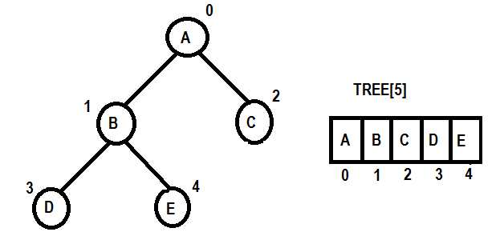
Example 01:

Slide 5
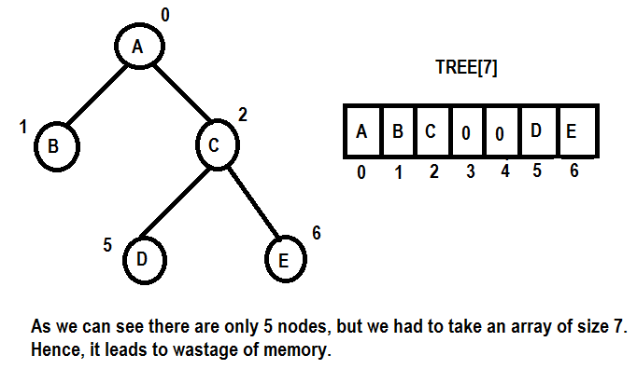
Example 02:

Slide 6
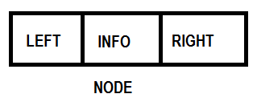
Linked Representation of Binary Tree
A binary tree can be represented using linked list, where each node is divided into 3 parts.
  INFO : It is used to store the information
  LEFT : It is a pointer that holds the address of left child
  RIGHT : It is a pointer that holds the address of right child
  Here we consider a special pointer ROOT which will hold the address of root node of the tree.

Slide 7
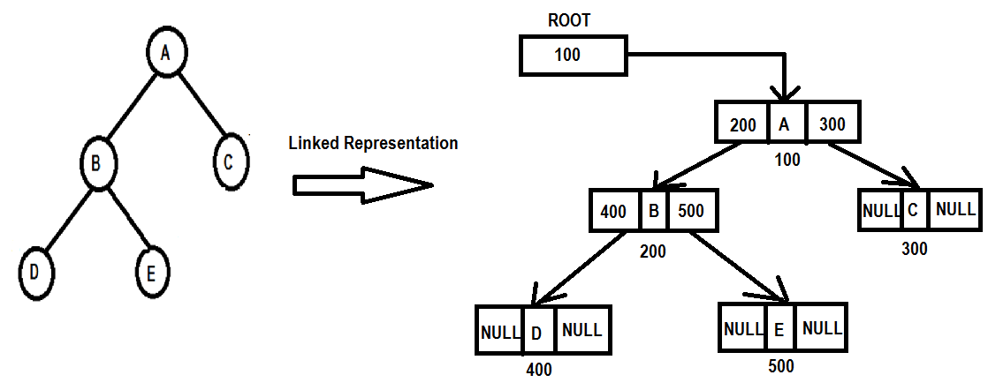
Example 01:

Slide 8
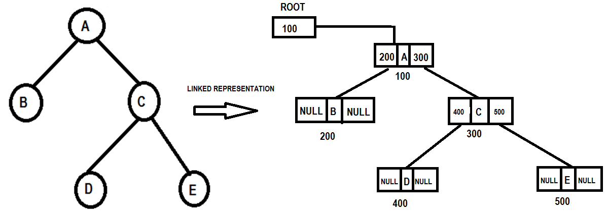
Example 02:

Slide 9
TREE TRAVERSAL
The process of visiting each node of the tree exactly once is called tree traversal.
The traversal of binary tree involves three basic activities such as:
  Visiting the Root Node
  Traversing Left sub-tree
  Traversing Right sub-tree
These basic activities are done in different order. There are 3 types of tree traversal methods:
  Pre-order Traversal
  In-order Traversal
  Post-order Traversal

Slide 10
TREE TRAVERSAL
The above tree traversal methods can be implemented in two ways:
  Recursive Tree Traversal
  Non-recursive Tree Traversal
Recursive Tree Traversal : The concept of recursion is used to traverse all the nodes of a binary tree.
Non-recursive Tree Traversal: We take the help of stack to traverse all the nodes of a binary tree.

Slide 11
RECURSIVE TREE TRAVERSAL - PreOrder
Pre-order Traversal (N-L-R)
[ N => Root Node, L => Left Sub-tree and R => Right Sub tree]
Sequence of nodes to be traversed :
Step 1: Visit the Root Node
Step 2: Traverse the left sub tree in Preorder
Step 3: Traverse the right sub tree in Preorder
Algorithm:
Preorder(node): [ Assume node holds the address of root node of the tree ]
Step 1: If (node!=NULL), Then
Step 1.1: Display INFO[node]
Step 1.2: Preorder(LEFT[node])
Step 1.3: Preorder(RIGHT[node])
[End of If – Step 1]
Step 2: Stop

Slide 12
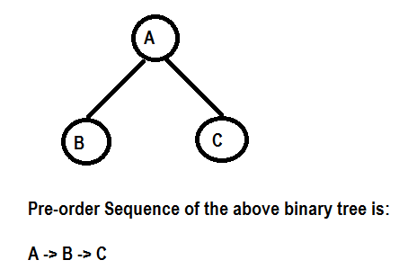
Example: 01 (PreOrder Traversal)

Slide 13
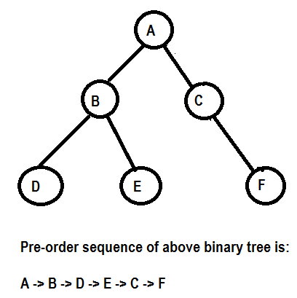
Example: 02 (PreOrder Traversal)

Slide 14
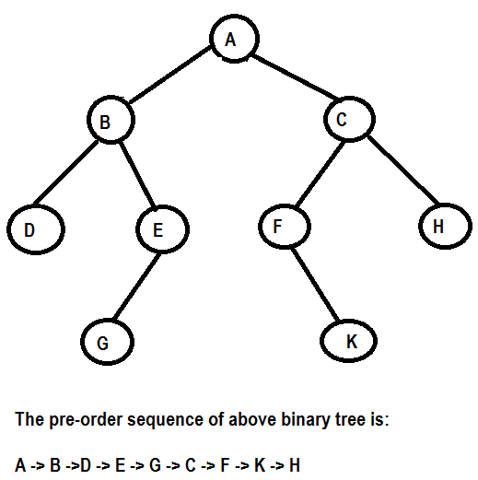
Example: 03 (PreOrder Traversal)

Slide 15
RECURSIVE TREE TRAVERSAL : InOrder
In-order Traversal (L-N-R)
[ N => Root Node, L => Left Sub-tree and R => Right Sub tree]
Sequence of nodes to be traversed :
Step 1: Traverse the left sub tree in In-order
Step 2: Visit the Root Node
Step 3: Traverse the right sub tree in In-order
Algorithm:
Inorder(node): [ Assume node holds the address of root node of the tree ]
Step 1: If (node!=NULL), Then
Step 1.1: Inorder(LEFT[node])
Step 1.2: Display INFO[node]
Step 1.3: Inorder(RIGHT[node])
[End of If – Step 1]
Step 2: Stop

Slide 16
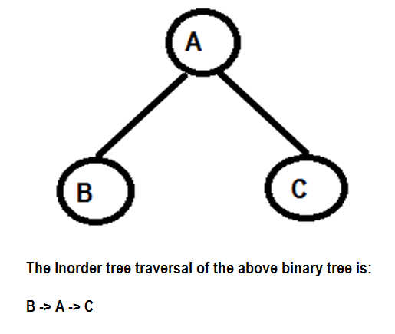
Example: 01 (InOrder Traversal)

Slide 17
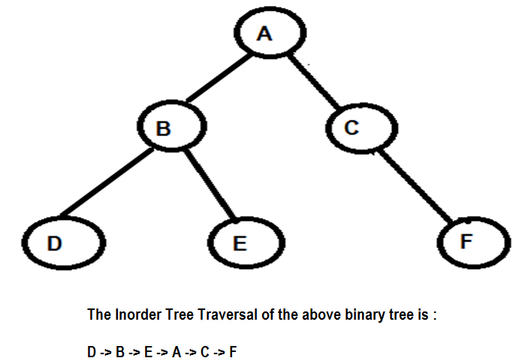
Example: 02 (InOrder Traversal)

Slide 18
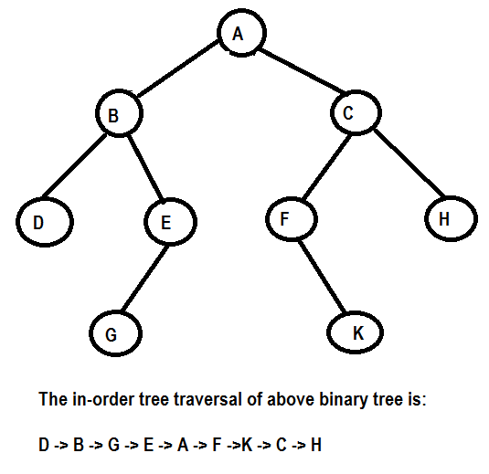
Example: 03 (InOrder Traversal)

Slide 19
RECURSIVE TREE TRAVERSAL : PostOrder
Post-order Traversal (L-R-N)
[ N => Root Node, L => Left Sub-tree and R => Right Sub tree]
Sequence of nodes to be traversed :
Step 1: Traverse the left sub tree in Post-order
Step 2: Traverse the right sub tree in Post-order
Step 3: Visit the Root Node
Algorithm:
Postorder(node): [ Assume node holds the address of root node of the tree ]
Step 1: If (node!=NULL), Then
Step 1.1: Postorder(LEFT[node])
Step 1.2: Postorder(RIGHT[node])
Step 1.3: Display INFO[node]
[End of If – Step 1]
Step 2: Stop

Slide 20
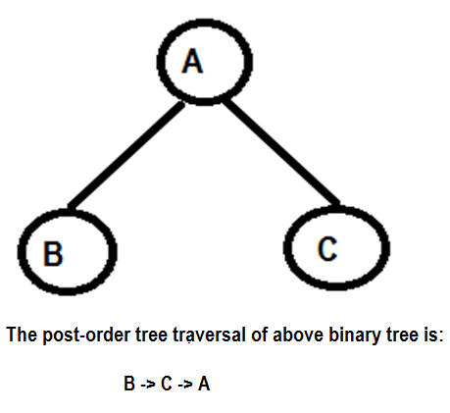
Example: 01 (PostOrder Traversal)

Slide 21
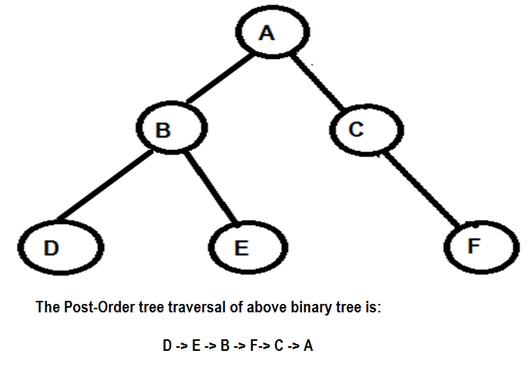
Example: 02 (PostOrder Traversal)

Slide 22
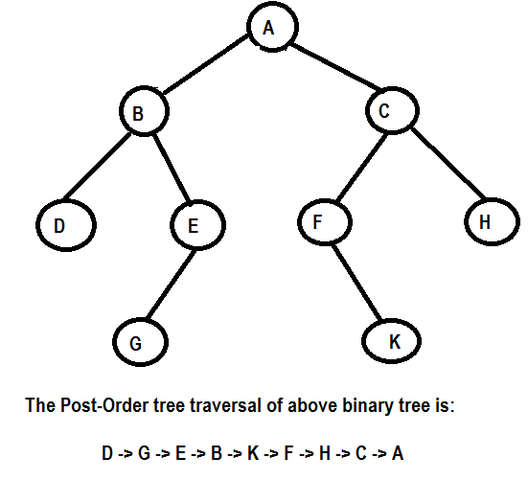
Example: 03 (PostOrder Traversal)

